Slide 1

Queuing Model
The Alley

Slide 2
Data Collection
Venue: The Alley
Date: 28th February 2020
Time:
Non-Peak Hour: Afternoon 12pm-3pm
Peak Hour: Night 6pm-9pm

Slide 3
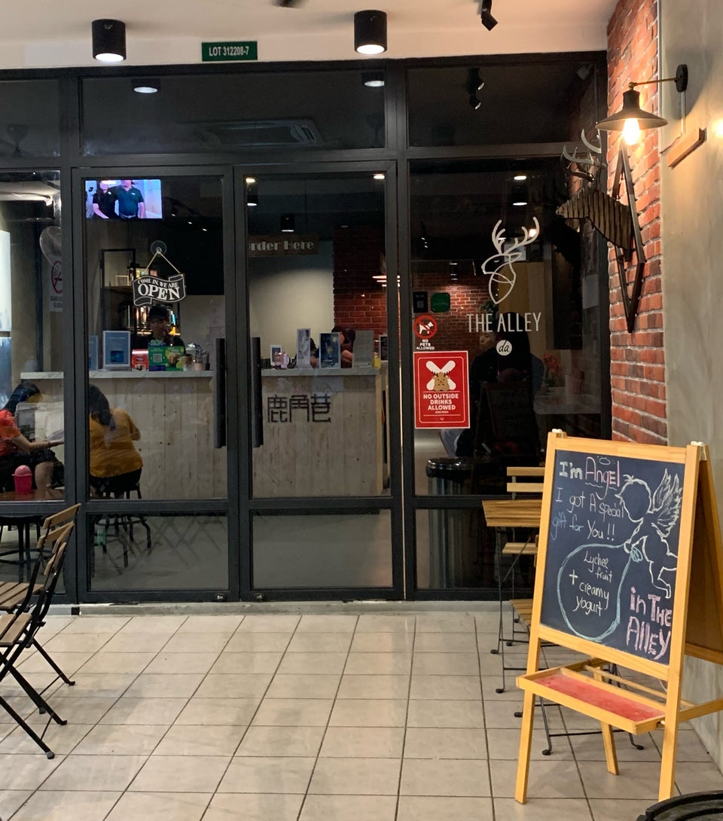
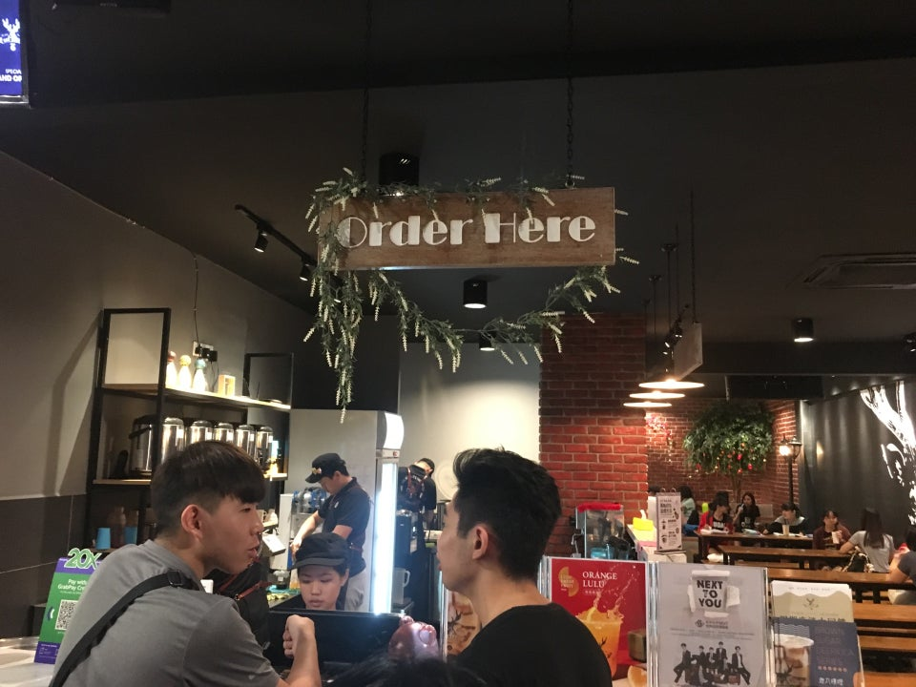
How it works?

Slide 4
Queuing Model
Kendall's Notation: M|M|1:FCFS|∞|∞
 | Non-Peak Hour | Peak Hour
Arrival Rate (λ) | 7.9823 customers per hour | 21.1765 customers per hour
Service Rate (µ) | 20.5714 customers per hour | 28.1250 customers per hour
Utilization Rate (ρ) | 0.3880 | 0.7529

Slide 5
The End
Any Question?

